Slide 1

Large Scale Data Driven Applications
Introduction to MapReduce, and MongoDB Storage Engine

Slide 2
Outlines
Understand the purpose and basics of the MapReduce framework.
Explore how MapReduce is applied in data processing.
Gain insight into MongoDB’s storage engines and their functionalities.

Slide 3
Big Data Challenges
Big Data refers to vast volumes of structured, semi-structured, and unstructured data generated at high velocity from various sources like social media, sensors, business transactions, etc.
Big Data Challenges
Storage and Management: Storing and organising large datasets.
Processing and Analysis: Extracting insights in a reasonable time.
Scalability: Handling growth in data without performance degradation.
Cost: Infrastructure and maintenance expenses for large data systems.
Why Traditional Processing Falls Short
Traditional database systems (e.g., SQL) are not optimised for unstructured or high-velocity data.
High memory and CPU requirements for processing massive datasets.

Slide 4
Big Data Challenges: Solution
Solution: Distributed Processing Models
Parallelism: Splitting data across multiple machines to process simultaneously.
Scalability and Flexibility: Adding resources as needed for growing data.
Fault Tolerance: Ensuring system reliability despite failures.
Key Technologies:
MapReduce: Framework designed to process large datasets in parallel across clusters.
NoSQL Databases (e.g., MongoDB): Databases optimised for large, often unstructured datasets.

Slide 5
Introduction to MapReduce Framework
Purpose of MapReduce:
A data processing paradigm for processing and generating large datasets with a parallel, distributed algorithm on a cluster.
Developed by Google to handle large-scale data processing.
Key Idea: Splits tasks across multiple nodes in a distributed system to allow parallel processing.
Real-world Applications: Used in web indexing, data mining, log analysis, machine learning, and more.

Slide 6
Key Components of MapReduce
Two Core Functions:
Map Function:
Called once per document
Processes input data and generates key-value pairs.
Reduce Function:
Aggregates the output of the Map function, reducing the key-value pairs to a result.
Data Flow in MapReduce: Data flows from input → map → shuffle & sort → reduce → output.

Slide 7
Map Function – How It Works
Input Splitting:
Input data is split into smaller blocks (chunks) that can be processed independently.
Execution:
Each chunk is processed by a Map function, producing intermediate key-value pairs.
Example: Word count application where each word from a document is mapped to a key (word) and a value (count of occurrences).
Example:
Input: ["apple", "banana", "apple", "orange", "banana", "apple"]
Map Output: {("apple", 1), ("banana", 1), ("apple", 1), ("orange", 1), ("banana", 1), ("apple", 1)}

Slide 8
Shuffle & Sort – Preparing for Reduction
Shuffle Phase:
Intermediate key-value pairs are sorted and grouped by keys.
Ensures that all values with the same key are routed to the same reducer.
Sort Phase:
The sorted data is grouped for efficiency in the Reduce phase.
Example: The pairs {("apple", 1), ("apple", 1), ("apple", 1)} are grouped together.

Slide 9
Reduce Function – Final Aggregation
Reduce Process:
Each unique key from the Map phase has its associated values aggregated in the Reduce phase.
Applies a function (e.g., sum, count) to produce the final output.
Example (Continuing from Map Example):
Input to Reducer: {("apple", [1, 1, 1]), ("banana", [1, 1]), ("orange", [1])}
Output: {("apple", 3), ("banana", 2), ("orange", 1)}

Slide 10
MapReduce Example: MongoDB
orders
Calculates the total amount spent by each customer (cust_id) with status: "A" and stores the aggregated result in the order_totals collection
{
cust_id: "A123",
amount: 500,
status: "A"
}
db.orders.mapReduce(
function() {
emit(this.cust_id, this.amount);
},
function(key, values) {
return Array.sum(values);
},
{
query: { status: "A" },
out: "order_totals"
}
)
{
cust_id: "A123",
amount: 250,
status: "A"
}
Map Function
{
cust_id: "A123",
amount: 300,
status: “D"
}
Reduce Function
{
cust_id: “B212",
amount: 200,
status: "A"
}
Options/Query
Notes:
The Map function iterates over each document in the orders collection that meets the query condition (status: "A").For each document, it emits a key-value pair where: key = cust_id; value = amount
The reduce function takes each unique cust_id (key) and an array of amount values (values) associated with that key. It returns the sum of the amount values, calculating the total amount for each customer.
In options: Query: Filters the documents to only include those with status: "A". Output Collection: Specifies that the result should be stored in a new collection called order_totals.

Slide 11
MapReduce Example: MongoDB
db.orders.mapReduce(
function() { emit(this.cust_id, this.amount); },
function(key, values) { return Array.sum(values); },
{ query: { status: "A" }, out: "order_totals" })
orders
{
cust_id: "A123",
amount: 500,
status: "A"
}
{
cust_id: "A123",
amount: 500,
status: "A"
}
{
cust_id: "A123",
amount: 250,
status: "A"
}
{
cust_id: "A123",
amount: 750
}
query
{
cust_id: "A123",
amount: 250,
status: "A"
}
map
reduce
{
cust_id: "A123",
amount: 300,
status: “D"
}
{ "A123", [500, 250] }
{ “B212", 200 }
{
cust_id: “B212",
amount: 200
}
{
cust_id: “B212",
amount: 200,
status: "A"
}
{
cust_id: “B212",
amount: 200,
status: "A"
}
order_totals

Slide 12
MapReduce: Advantages and Limitations
Advantages of MapReduce
Scalability: Efficiently processes large datasets by distributing tasks.
Fault Tolerance: Automatically manages node failures during processing.
Flexibility: Supports a variety of data formats (structured, semi-structured, unstructured).
Simplicity in Parallel Processing: Provides a high-level abstraction for distributed computation.
Limitations of MapReduce
Not Real-Time: Designed for batch processing; unsuitable for real-time data processing.
Programming Complexity: Requires a different approach to algorithm design.
Iterative Processing: Inefficient for iterative tasks, such as those in machine learning.
Dependency on Disk I/O: Heavy reliance on disk I/O can lead to slower performance compared to in-memory processing frameworks.

Slide 13
Transition to MongoDB
Connecting MapReduce to MongoDB:
Some NoSQL databases like MongoDB incorporate MapReduce capabilities.
Using MongoDB’s Aggregation Framework:
Allows similar functionality to MapReduce but with more optimised query handling for document-based data.
Various map-reduce operations can be rewritten using aggregation pipeline operators, such as $group, $merge, $accumulator, etc.

Slide 14
MongoDB Storage Engines
A storage engine is the component of a database responsible for how data is stored, retrieved, and managed on disk or in memory.
It is like the “backbone” of the database, controlling data durability, speed, and efficiency.
Key Functions:
Manages data storage and retrieval.
Handles indexing, compression, and encryption.
Controls concurrency and journaling for crash recovery.
MongoDB provides a variety of storage engines, allowing you to choose one most suited to your application.

Slide 15
Importance of Storage Engines
Performance: Storage engines impact the speed of read/write operations.
Concurrency: Some storage engines support higher concurrent access, which is essential for applications with many simultaneous users.
Storage Efficiency: Some engines use compression techniques to reduce the amount of disk space used.
Data Durability and Journaling: Journaling is a feature in many storage engines that helps ensure data durability and recovery after unexpected failures.
What is Journaling?:
Journaling records data changes in a special log file before committing them to the main database files.
If a crash occurs, MongoDB can use the journal to restore the database to a consistent state.
Why Journaling Matters: For databases handling critical data, journaling ensures that even in cases of power loss or crashes, recent changes can be recovered, maintaining data integrity.

Slide 16
MongoDB Storage Engines
MongoDB's Flexible Architecture: MongoDB supports multiple storage engines, allowing users to choose one that best fits their application needs.
Popular Storage Engines in MongoDB:
WiredTiger: The default, designed for high concurrency, data compression, and efficient use of resources.
In-Memory: For applications needing high-speed data access without persistence requirements.
Legacy Engine (MMAPv1 - Deprecated): Previously MongoDB’s main engine, it’s no longer recommended but helps understand MongoDB’s evolution.

Slide 17
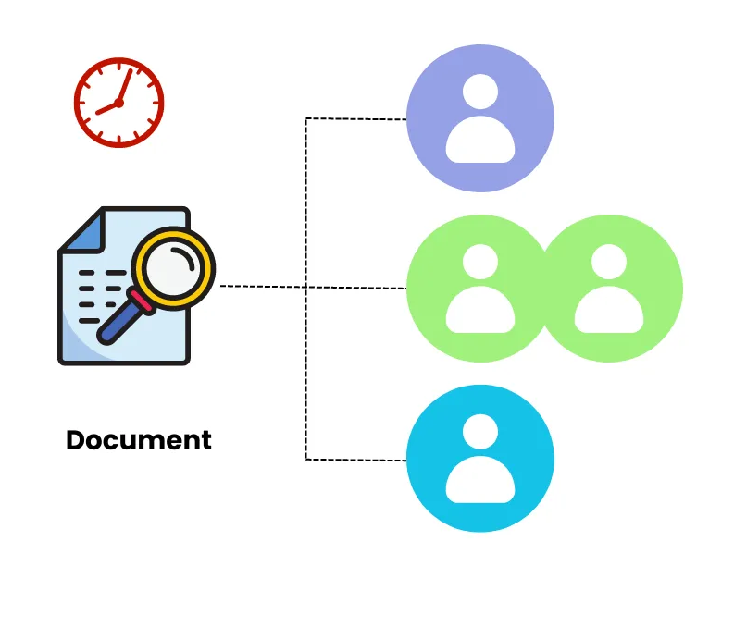
MongoDB Storage Engines
Document Level Concurrency and Locking
WiredTiger supports document-level concurrency, allowing multiple read and write operations to occur simultaneously.
To ensure consistency, it uses locking and other concurrency control measures.
MongoDB uses multi-granularity locking that allows operations to lock at the global, database, collection or document level.
For most read and write operations, WiredTiger uses optimistic concurrency control.
When the storage engine detects a conflict between two operations, it prompts MongoDB to automatically retry the conflicting operation.
Advantages:
High Throughput: Improved performance in multi-user environments.
Reduced Wait Times: Allows more efficient processing of concurrent transactions.
Image source: https://www.mydbops.com/blog/master-mongodb-write-conflicts-causes-impact-and-solutions
Notes:
Unlike older MongoDB engines, which used collection- or database-level locking, WiredTiger allows more granular, document-level locking. This is particularly beneficial for applications with high read and write operations, where document-level locking reduces conflicts and improves responsiveness.

Slide 18
MongoDB Storage Engines
Snapshots and Checkpoints
Snapshots and checkpoints are mechanisms for maintaining data consistency and facilitating data recovery.
WiredTiger periodically creates snapshots to preserve a stable view of data.
At the start of an operation, WiredTiger provides a point-in-time snapshot of the data to the transaction. A snapshot presents a consistent view of the in-memory data.
WiredTiger writes snapshots to disk consistently across all data files, ensuring data coherence and durability.
Checkpoints act as recovery points, allowing systems to restore data to a stable state in case of a failure, thereby minimising data loss.
Each checkpoint captures a consistent state, making it a reliable fallback point and helping with performance by reducing the frequency of disk writes.
Notes:
Snapshots help with read consistency, ensuring that reads can occur without being affected by concurrent writes. Checkpoints improve durability, as they help ensure data isn't lost in a crash, but the checkpoint frequency impacts performance and data durability balance.

Slide 19


MongoDB Storage Engines
Journaling and Write-Ahead Logging
WiredTiger uses journaling with a write-ahead logging (WAL) technique, ensuring data durability and crash recovery.
Journaling: Each write operation is recorded in a journal, which can be replayed to restore data if the system crashes.
Write-Ahead Logging: Changes are written to the journal before they’re applied to the main database file, ensuring data integrity.
helps ensure that MongoDB can recover recent transactions in the event of a crash.
Journaling is a key feature for applications requiring high durability and reliability, as it preserves the latest operations safely.
write operations
Mongod
writes
Journal
writes
Data file

Slide 20
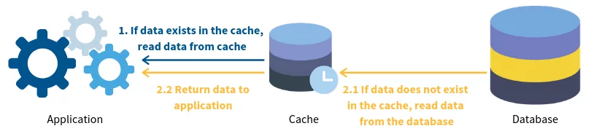
MongoDB Storage Engines
Memory and Cache Management
WiredTiger uses sophisticated memory and cache management to handle data efficiently.
Cache: WiredTiger’s cache stores frequently accessed data, which reduces the need to repeatedly fetch data from disk, enhancing performance.
Eviction: When cache size limits are reached, WiredTiger evicts the least recently used data to make space, maintaining optimal memory usage.
storage:
wiredTiger:
engineConfig:
cacheSizeGB: <desired_cache_size_in_GB>
Source: https://codeforgeek.com/caching-a-mongodb-database-with-redis/
The wiredTiger.cacheSizeGB setting defines the maximum size of the cache in gigabytes. It is specified in MongoDB's configuration file (mongod.conf) under the storage and wiredTiger sections
By default, MongoDB allocates 50% of the system's available RAM (minus 1 GB) to the WiredTiger cache if this setting isn’t specified.
On systems with less than 1 GB of RAM, MongoDB sets the cache to a lower value to avoid memory overuse.

Slide 21
MongoDB - GridFS
GridFS is the MongoDB specification for storing and retrieving large files such as images, audio files, video files, etc.
GridFS has the capability to store files even greater than its document size limit of 16MB.
GridFS divides large files into smaller chunks (default size: 255 KB) and stores them as separate documents within two collections: fs.chunks and fs.files.
Each chunk is identified by its unique _id ObjectId field. The fs.files serves as a parent document. The files_id field in the fs.chunks document links the chunk to its parent.

Slide 22
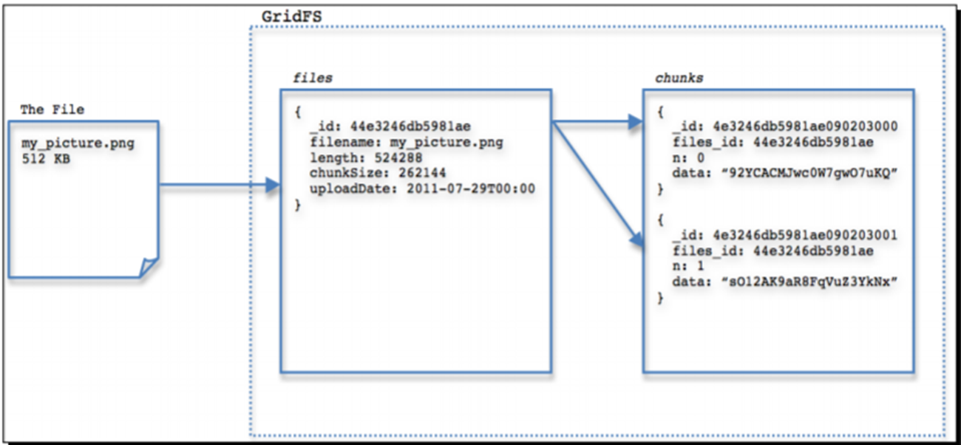
MongoDB - GridFS
The diagram shows how an image file of 512 KB is stored in GridFS. The document in files contains the filename, size, time when the file was uploaded, and so on. The file is split into two 256 KB chunks, each chunk referring to the document in files with its files_id field.

Slide 23
MongoDB - GridFS
Upload a File:
mongofiles --db mydatabase --bucket mybucket put myfile.jpg
This uploads myfile.jpg to the mydatabase GridFS, in the mybucket bucket.
Download a File:
mongofiles --db mydatabase --bucket mybucket get myfile.jpg
This downloads myfile.jpg from the GridFS collection in mybucket.
List Files in GridFS:
mongofiles --db mydatabase --bucket mybucket list
Lists all files stored in GridFS within mybucket.
Delete a File from GridFS:
mongofiles --db mydatabase --bucket mybucket delete myfile.jpg
Deletes myfile.jpg from the specified GridFS bucket.

Slide 24
MongoDB Storage Engine
In-Memory Storage Engine
This engine keeps all data in memory, with no persistent storage on disk.
All data operations occur in memory, making read and write operations significantly faster.
Since data isn’t stored on disk, there’s no need for journaling, but this means data is lost if the server restarts or crashes.
Best for caching scenarios or data analysis tasks where data persistence isn’t critical.
Suitable for real-time analytics or temporary data processing where data can be regenerated if lost.

Slide 25
MongoDB Storage Engine
MMAPv1 Storage Engine (Legacy)
MMAPv1 was MongoDB’s original storage engine but has been deprecated in favor of WiredTiger.
Data was stored using memory-mapped files, which had limitations in concurrency and scalability.
Limited concurrent writes due to collection-level locking, making it less efficient for high-concurrency applications.
Historically used in early MongoDB versions but has largely been phased out due to performance limitations.

Slide 26
Choosing a MongoDB Storage Engine
Decision Factors:
Data Durability Requirements: If durability is essential, WiredTiger is generally preferable due to its journaling feature.
Performance Needs: For ultra-fast data processing (e.g., caching), the In-Memory engine may be a better choice.
Storage Efficiency: WiredTiger’s data compression can save on storage costs compared to alternatives.
Real-World Scenarios:
WiredTiger for high-availability applications (e.g., e-commerce, social media).
In-Memory engine for temporary, high-speed analytics in data science projects.
True
True
True

Slide 27
Questions?

